Slide 1

Google Assistant Controlled LED

Slide 2
WHAT IS THE PROJECT ABOUT??
SO, BASICALLY OUR PROJECT IS A MINI VERSION OF HOUSE AUTOMATION USING GOOGLE ASSISTANT…... IT’S MINI BECAUSE HERE WE ARE ONLY CONTROLLING “LED” AND NOT THE WHOLE HOUSE SYSTEM.
we will use Google Assistant with Adafruit IO to control an LED with ESP32. Here we have used IFTTT to access Google Assistant and to control LED by voice commands.

Slide 3
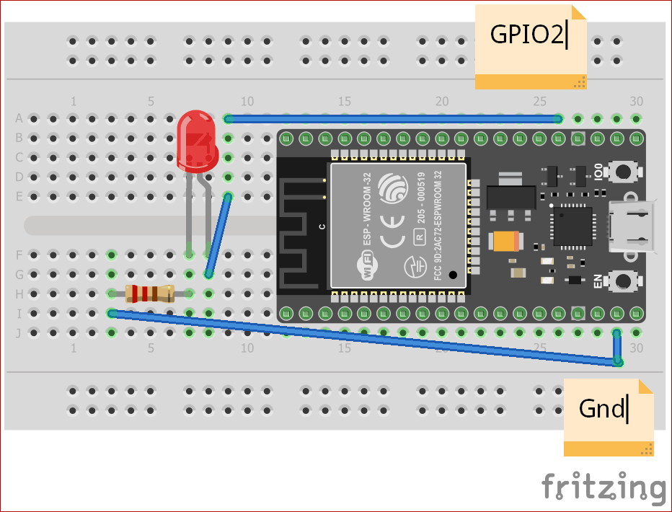
Google Assistant Controlled LED using ESP32 and Adafruit IO -

Slide 4
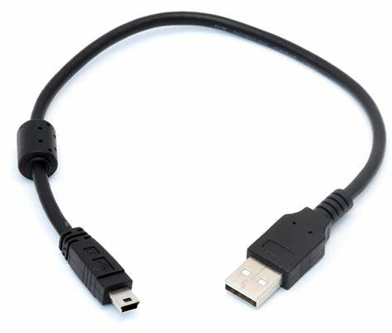
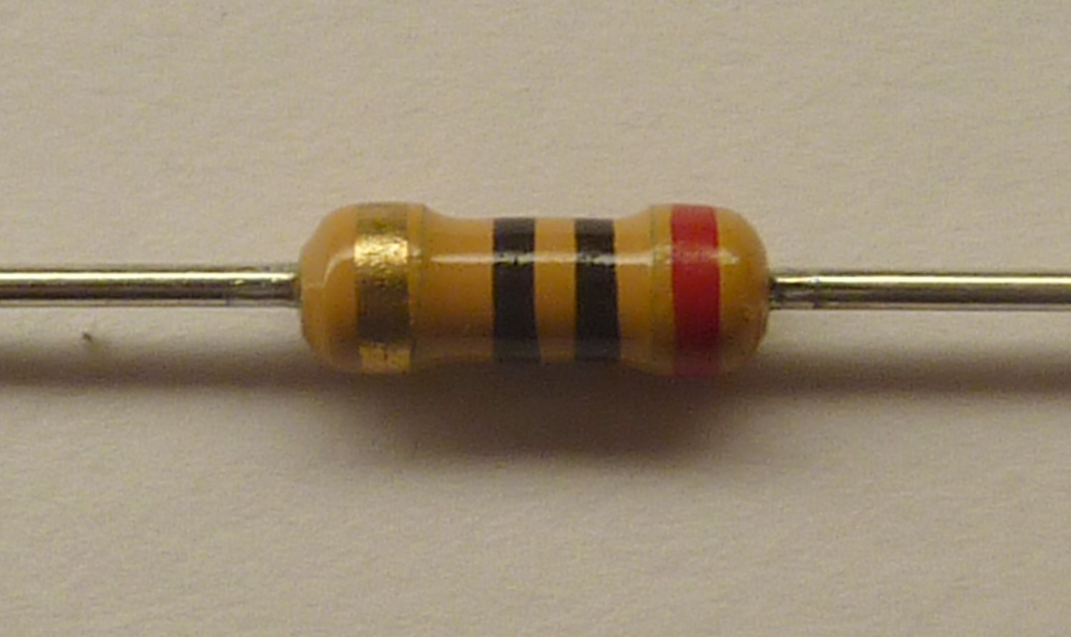
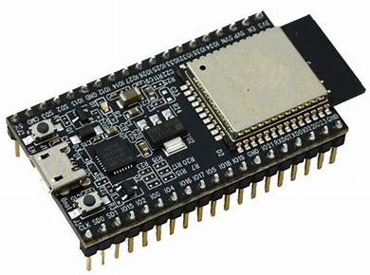
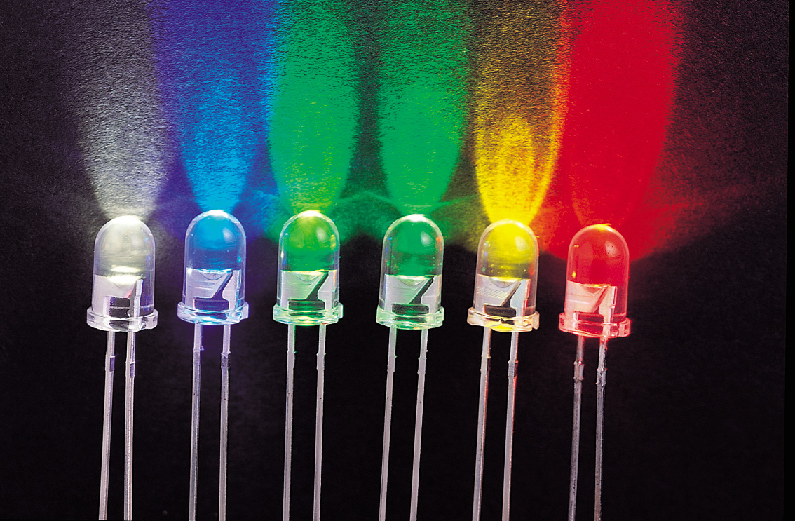

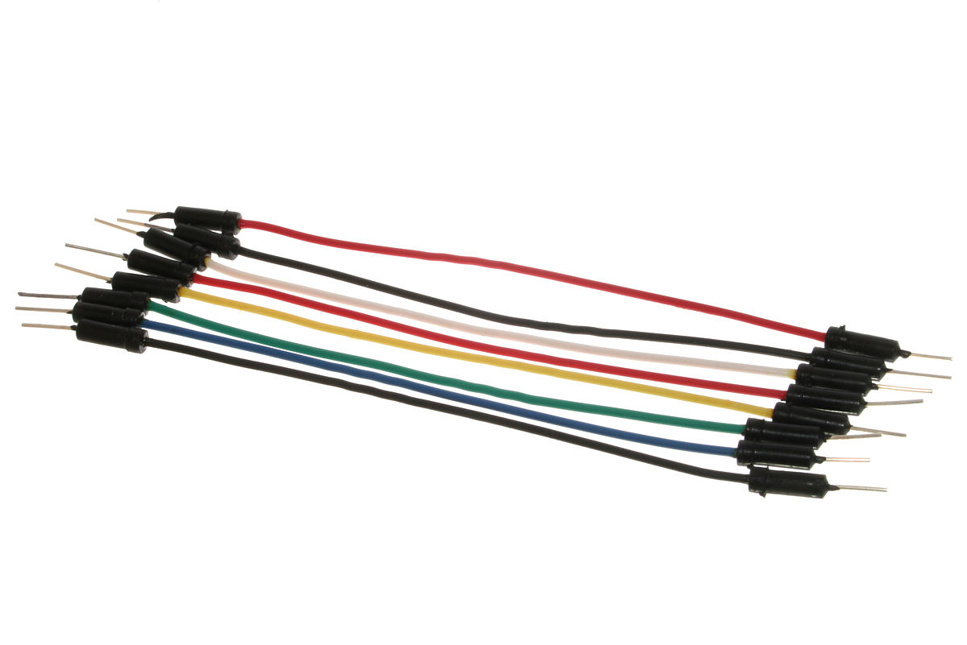
-:COMPONENT REQUIRED :–
ESP32 module
USB cable
Breadboard
LED
Resistor and jumper wires
Google assistant enabled device.
Account on Adafruit IO
Account on IFTTT
Google account- same account for which you are using Google Assistant.
This Photo by Unknown Author is licensed under CC BY-SA

Slide 5
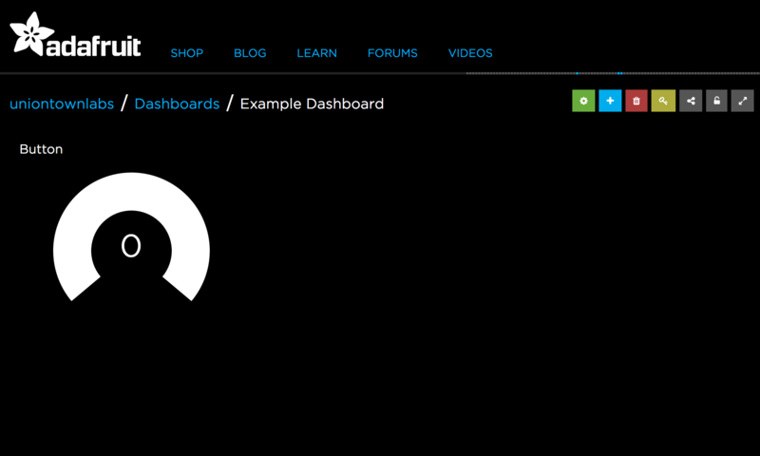
Adafruit IO:-
Adafruit.io is a cloud service – that just means adafruit run it for you and you don’t have to manage it.
Adafruit IO is a system that makes data useful.
-:ESP32
Is a series of low-cost, low-power system on a chip microcontrollers with integrated Wi-Fi and dual-mode Bluetooth.

Slide 6

SO BASICALLY, OUR PROJECT USE VOICE TECHNOLOGY...
BUT WHAT IS A VOICE SEARCH??

Slide 7

WHAT IS VOICE ACTION??
Google Voice Actions let users quickly complete tasks in your app using voice commands.
VOICE ACTION makes spoken human interaction with computers possible, using speech recognition to understand spoken commands and answer questions, and typically text to .

Slide 8
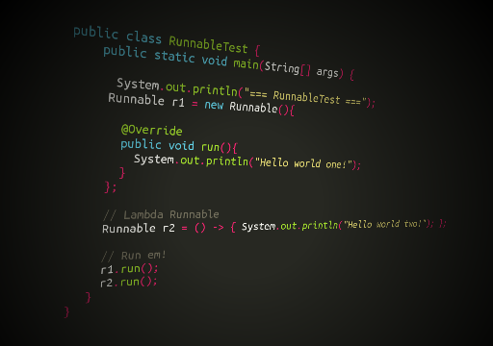
--:Source _CODE :--

Slide 9

void MQTT_connect();
void setup() {
Serial.begin(115200);
delay(10);
pinMode(2,OUTPUT);
// Connect to WiFi access point.
Serial.println(); Serial.println();
Serial.print("Connecting to ");
Serial.println(WLAN_SSID);
WiFi.begin(WLAN_SSID, WLAN_PASS);
while (WiFi.status() != WL_CONNECTED) {
delay(500);
Serial.print(".");
}
Serial.println();
Serial.println("WiFi connected");
Serial.println("IP address: "); Serial.println(WiFi.localIP());
mqtt.subscribe(&LED_Control);
}
#include <WiFi.h>
#include "Adafruit_MQTT.h"
#include "Adafruit_MQTT_Client.h"
#define WLAN_SSID "Ashish"
#define WLAN_PASS "12345678"
#define AIO_SERVER "io.adafruit.com"
#define AIO_SERVERPORT 1883
#define AIO_USERNAME "khandelwalashish129"
#define AIO_KEY "350c30c9c8864eabb26458c547XXXXXX"
int output=2;
WiFiClient client;
// Create an ESP8266 WiFiClient class to connect to the MQTT server.
Adafruit_MQTT_Client mqtt(&client, AIO_SERVER, AIO_SERVERPORT, AIO_USERNAME, AIO_KEY);
// Setup the MQTT client class by passing in the WiFi client and MQTT server and login details.
Adafruit_MQTT_Subscribe LED_Control = Adafruit_MQTT_Subscribe(&mqtt, AIO_USERNAME "/feeds/LED_Control");
void MQTT_connect();
void setup() {
Serial.begin(115200);
delay(10);
pinMode(2,OUTPUT);
#include <WiFi.h>
#include "Adafruit_MQTT.h"
#include "Adafruit_MQTT_Client.h"
#define WLAN_SSID "Ashish"
#define WLAN_PASS "12345678"
#define AIO_SERVER "io.adafruit.com"
#define AIO_SERVERPORT 1883
#define AIO_USERNAME "khandelwalashish129"
#define AIO_KEY "350c30c9c8864eabb26458c547XXXXXX"
int output=2;
WiFiClient client; // Create an ESP8266 WiFiClient class to connect to the MQTT server.
Adafruit_MQTT_Client mqtt(&client, AIO_SERVER, AIO_SERVERPORT, AIO_USERNAME, AIO_KEY); // Setup the MQTT client class by passing in the WiFi client and MQTT server and login details.
Adafruit_MQTT_Subscribe LED_Control = Adafruit_MQTT_Subscribe(&mqtt, AIO_USERNAME "/feeds/LED_Control");

Slide 10
void MQTT_connect();
void setup() {
Serial.begin(115200);
delay(10);
pinMode(2,OUTPUT);
// Connect to WiFi access point.
Serial.println(); Serial.println();
Serial.print("Connecting to ");
Serial.println(WLAN_SSID);
WiFi.begin(WLAN_SSID, WLAN_PASS);
while (WiFi.status() != WL_CONNECTED) {
delay(500);
Serial.print(".");
}
Serial.println();
Serial.println("WiFi connected");
Serial.println("IP address: "); Serial.println(WiFi.localIP());
mqtt.subscribe(&LED_Control);
}
#include <WiFi.h>
#include "Adafruit_MQTT.h"
#include "Adafruit_MQTT_Client.h"
#define WLAN_SSID "Ashish"
#define WLAN_PASS "12345678"
#define AIO_SERVER "io.adafruit.com"
#define AIO_SERVERPORT 1883
#define AIO_USERNAME "khandelwalashish129"
#define AIO_KEY "350c30c9c8864eabb26458c547XXXXXX"
int output=2;
WiFiClient client; // Create an ESP8266 WiFiClient class to connect to the MQTT server.
Adafruit_MQTT_Client mqtt(&client, AIO_SERVER, AIO_SERVERPORT, AIO_USERNAME, AIO_KEY); // Setup the MQTT client class by passing in the WiFi client and MQTT server and login details.
Adafruit_MQTT_Subscribe LED_Control = Adafruit_MQTT_Subscribe(&mqtt, AIO_USERNAME "/feeds/LED_Control");
// Connect to WiFi access point.
Serial.println(); Serial.println();
Serial.print("Connecting to ");
Serial.println(WLAN_SSID);
WiFi.begin(WLAN_SSID, WLAN_PASS);
while (WiFi.status() != WL_CONNECTED) {
delay(500);
Serial.print(".");
}
Serial.println();
Serial.println("WiFi connected");
Serial.println("IP address: "); Serial.println(WiFi.localIP());
mqtt.subscribe(&LED_Control);
}
uint32_t x=0;
void loop()
{
MQTT_connect();
Adafruit_MQTT_Subscribe *subscription;
while ((subscription = mqtt.readSubscription(5000))) {

Slide 11
void MQTT_connect();
void setup() {
Serial.begin(115200);
delay(10);
pinMode(2,OUTPUT);
// Connect to WiFi access point.
Serial.println(); Serial.println();
Serial.print("Connecting to ");
Serial.println(WLAN_SSID);
WiFi.begin(WLAN_SSID, WLAN_PASS);
while (WiFi.status() != WL_CONNECTED) {
delay(500);
Serial.print(".");
}
Serial.println();
Serial.println("WiFi connected");
Serial.println("IP address: "); Serial.println(WiFi.localIP());
mqtt.subscribe(&LED_Control);
}
#include <WiFi.h>
#include "Adafruit_MQTT.h"
#include "Adafruit_MQTT_Client.h"
#define WLAN_SSID "Ashish"
#define WLAN_PASS "12345678"
#define AIO_SERVER "io.adafruit.com"
#define AIO_SERVERPORT 1883
#define AIO_USERNAME "khandelwalashish129"
#define AIO_KEY "350c30c9c8864eabb26458c547XXXXXX"
int output=2;
WiFiClient client; // Create an ESP8266 WiFiClient class to connect to the MQTT server.
Adafruit_MQTT_Client mqtt(&client, AIO_SERVER, AIO_SERVERPORT, AIO_USERNAME, AIO_KEY); // Setup the MQTT client class by passing in the WiFi client and MQTT server and login details.
Adafruit_MQTT_Subscribe LED_Control = Adafruit_MQTT_Subscribe(&mqtt, AIO_USERNAME "/feeds/LED_Control");
if (subscription == &LED_Control) {
Serial.print(F("Got: "));
Serial.println((char *)LED_Control.lastread);
if (!strcmp((char*) LED_Control.lastread, "ON"))
{
digitalWrite(2, HIGH);
}
else
{
digitalWrite(2, LOW);
}
}
}

Slide 12
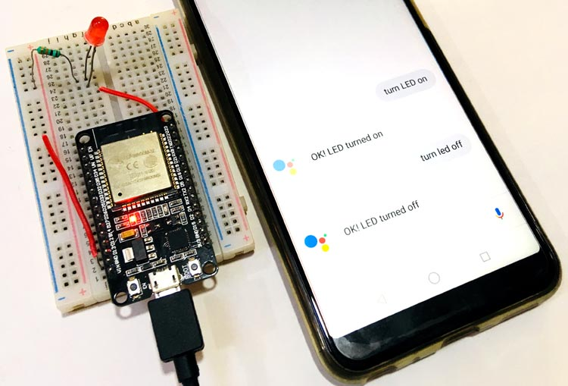
To Google assistant in your Android give voice command like “Turn LED on” or “Turn LED off” AND it will respond us like we have designed the code and you will observe change of LED state

Slide 13

The future of the Google Assistant: Helping you get things done to give you time back…..

Slide 14



